Slide 1
Project Management Concepts

Slide 2
What is a project
Unique a set of coordinated and controlled activities with clearly defined start and finish dates, undertaken to achieve an objective conforming to specific requirements
A Project is a planned set of activities
A Project has a scope
A Project has time, cost, quality and resource constraints
A Project is temporary
Notes:
The project manager according to Kerzner, (2013: 38) is responsible for coordinating and integrating activities across multiple functional lines. The integration of these activities include:
● Integrating the activities necessary to develop a project plan
● Integrating the activities necessary to execute the plan
● Integrating the activities necessary to make changes to the plan

Slide 3
What is NOT a project?
Implementation of new IT system
Launch of a new product line
Tracking of ongoing maintenance at a power plant
Rebranding an established product
Train employees on new system
Source: APP 2015/2016, 2011 KZN Hospital Survey
Notes:
The project manager according to Kerzner, (2013: 38) is responsible for coordinating and integrating activities across multiple functional lines. The integration of these activities include:
● Integrating the activities necessary to develop a project plan
● Integrating the activities necessary to execute the plan
● Integrating the activities necessary to make changes to the plan

Slide 4
Project constraints
A project schedule is a timetable that specifies the start and finish of each activity of the project. Problems will arise if the work is not timeously carried out. Sometimes it is not possible to continue with a specific task as it may depend on the completion of other tasks before it can be done.
Resources include: people, materials, equipment, facilities, funding etc. that are necessary to accomplish the project deliverables and objectives. The lack of materials, equipment and facilities including funding can also negatively affect the project deliverable and project objective.
Time
Cost
Quality
The work undertaken in every step of the project must be of quality. Expectations on quality is defined from the onset of a project. The quality of the work must meet specifications.
Notes:
The project manager according to Kerzner, (2013: 38) is responsible for coordinating and integrating activities across multiple functional lines. The integration of these activities include:
● Integrating the activities necessary to develop a project plan
● Integrating the activities necessary to execute the plan
● Integrating the activities necessary to make changes to the plan

Slide 5
Project Life Cycle
Initiation
Planning
Performing
Closeout
Identify need
Articulate the benefits.
Prepare project charter.
Authorise project
Define requirements.
Define quality and quantities
Define baseline plan
Direct and manage the work packages.
Execute the activities as per the schedule.
Track Progress
Compare actual against plan
Adjust plan if necessary
Verify work complete
Close contract
Admin closeout
Project Manager
Change Management and Stakeholder Management
Integration of activities
RESOURCES (Capital, Material, Equipment)
INTEGRATION PROCESSES
OUTPUT (Products, Services, Profit)
Notes:
The project manager according to Kerzner, (2013: 38) is responsible for coordinating and integrating activities across multiple functional lines. The integration of these activities include:
● Integrating the activities necessary to develop a project plan
● Integrating the activities necessary to execute the plan
● Integrating the activities necessary to make changes to the plan

Slide 6

The project management process
1. Establish a plan
2. Execute the plan
1
Establish project objective
1
Perform the work
2
Define the scope
2
Monitor and control progress
3
Create a WBS
3
Change management
4
Assign responsibility
5
Define activities
6
Sequence activities
7
Estimate activity resources
8
Develop project schedule
9
Determine budget
Notes:
shows the typical life-cycle phases that an organization goes through to implement project management. In the first phase, the Embryonic Phase, the organization recognizes the apparent need for project management. This recognition normally takes place at the lower and middle levels of management where the project activities actually take place. The executives are then informed of the need and assess the situation.

Slide 7
Activities
Why is it important to evaluate the performance of a project upon completion?
What are some of the factors that constrain a project?
Why is it important for the Project Manager and his/her team to communicate regularly and effectively with a project's stakeholders?
Notes:
shows the typical life-cycle phases that an organization goes through to implement project management. In the first phase, the Embryonic Phase, the organization recognizes the apparent need for project management. This recognition normally takes place at the lower and middle levels of management where the project activities actually take place. The executives are then informed of the need and assess the situation.

Slide 8
Initiating a project

Slide 9

Project identification and selection
A project charter is a document that formally authorises the project that has been selected.
Project identification
Project selection
Project charter
Need
1
Project title
Develop a set of criteria against which the project will be evaluated.
2
The purpose
3
Project description
Problem
List assumptions.
4
Objective
Gather data and information for each project.
5
Benefits
6
Funding
Opportunity
7
Major deliverables
Evaluate each project against the criteria.
8
Acceptance criteria
9
Milestone schedule

Slide 10
Activity
A milestone schedule is a list of target dates or times when each key event will occur. Consider an example, where a homeowner wishes to add a new bedroom to the house. Suggest key milestones and target times for this project.

Slide 11

Request for Proposal
A request for proposal (RFP) is a document, prepared by the sponsor/customer, which defines the project requirements and is used to solicit a proposal from potential contractors to do the project.
objective
deliverables
terms
budget
schedule
requirements
SOW
payment
due date

Slide 12
Developing project proposals

Slide 13
Proposal structure
Technical
Management
Cost
Describe the approach that will be used to solve the problem.
Indicate clearly how the proposed approach or solution will benefit the customer
Describe major tasks.
List all deliverables.
Describe project org. structure.
Highlight prior experience.
Labour costs
Material costs
Equipment costs.
Facilities cost.
Travel costs.

Slide 14
Fixed Price Contracts
The price will be fixed
Customer and the contractor are in agreement on the price.
The price can only change by agreement of both the customer and contractor.
This is a low risk contract for the customer.
High risk for the contractor
Customer will also pay the profit amount to the contractor.
High risk for the customer.
Low risk to the contractor.
Based on cost plus margin.
The contractor's reputation can be hurt if costs are highly overrun
Fixed price
Cost reimbursement
Notes:
The end result of the feasibility study is a management decision on whether to terminate the project or to approve its next phase. Although management can stop the project at several later phases, the decision is especially critical at this point, because later phases require a major commitment of resources.

Slide 15
Planning, Performing & Controlling

Slide 16
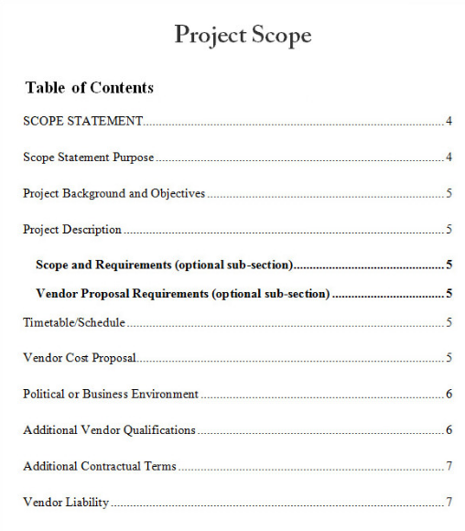
Example of SOW

Slide 17
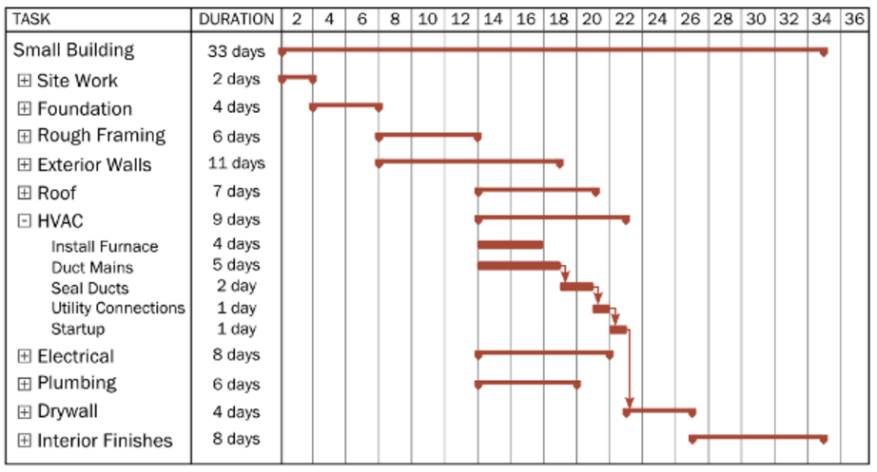
Example of Milestone Schedule

Slide 18
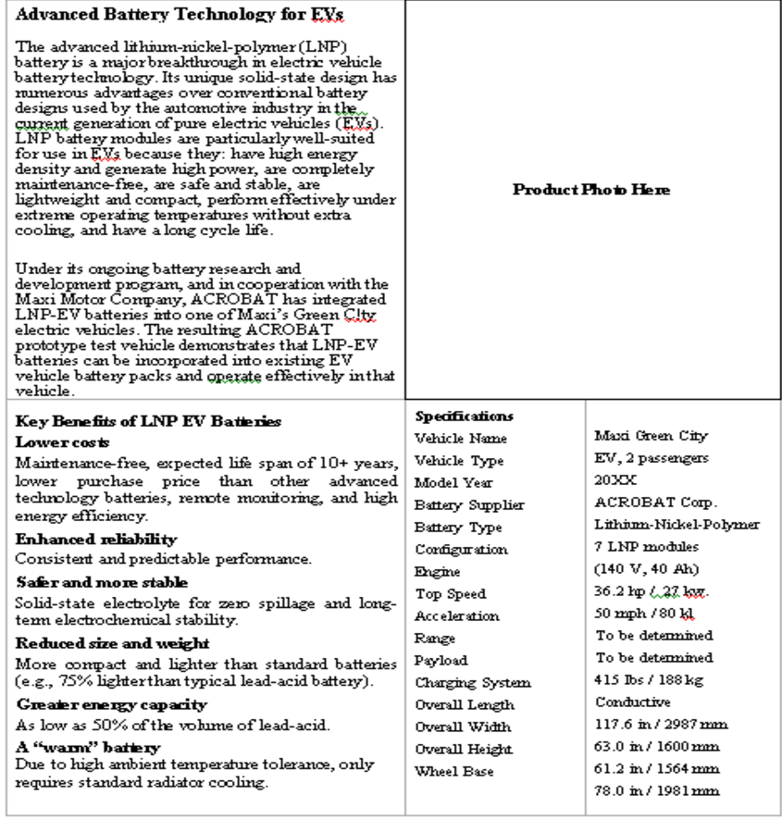
Example of Specification document

Slide 19
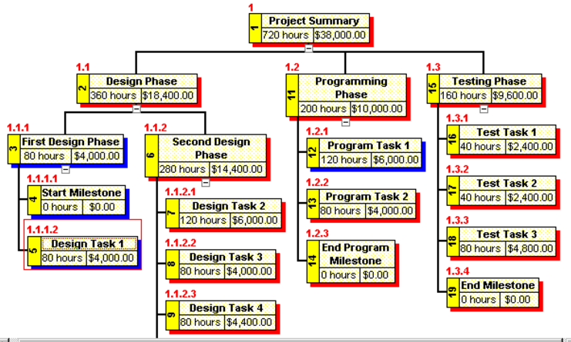
Example of a WBS

Slide 20
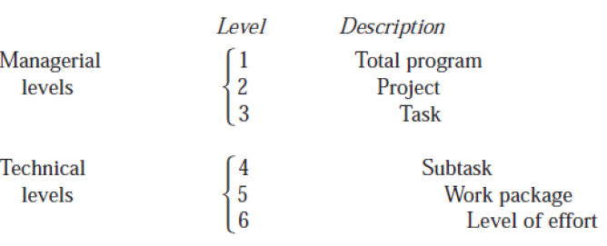
WBS
Build house
Design; Construct
Foundation, Walls, Roof
Mark up, Trenching, Concrete
Plot layout, Dig Foundation
Day 1, Dig west side, Day 2 dig east side
The top three levels of the WBS reflect integrated efforts and should not be related to one specific department. Effort required by departments or sections should be defined in subtasks and work packages.
Each element of work should be assigned to one and only one level of effort.
The summation of all elements in one level must be the sum of all work in the next lower level.

Slide 21
Network diagram
“A network diagram is a tool for arranging the specific activities in the appropriate sequence and defining their dependent relationships. It defines the sequence of how the activities will be done”.
Dig foundation
Pour concrete
Wait for concrete to cure
1
2
3
Notes:
• Mixing Tasks, specifications, approvals and special instructions,
• Using imprecise language (nearly, optimum, approximately etc.)
• Lack of a pattern, structure or chronological order,
• Wide variation in size of tasks,
• Wide variation in how to describe details of the work,
• Failing to get third party review.

Slide 22
PROJECT SCHEDULE

Slide 23
Scheduling Techniques
The objective of planning is to completely define all work required usually through a scope of work document so that the plan is readily identifiable to each project participant.
● Gantt or bar charts
● Milestone charts
● Networks
● Program Evaluation and Review Technique (PERT)
● Arrow Diagram Method (ADM)
● Precedence Diagram Method (PDM)
Notes:
The end result of the feasibility study is a management decision on whether to terminate the project or to approve its next phase. Although management can stop the project at several later phases, the decision is especially critical at this point, because later phases require a major commitment of resources.

Slide 24
Activity 1
What is critical path?
What is slack time?
Notes:
Critical Path: This is the longest path through the network and determines the duration of the project. It is also the shortest amount of time necessary to accomplish the project.
slack is the amount of time that a task in a project network can be delayed without causing a delay to: subsequent tasks ("free float") project completion date
It refers to the difference between the late and early start times of an activity.

Slide 25
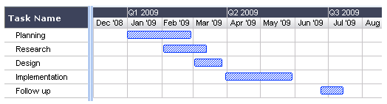
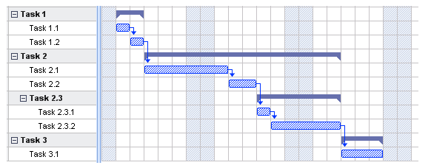
GANTT CHART
What is a Gantt Chart?
Shows you what has to be done (the activities/task) and when (the schedule)
Use it during status update meetings, reports, etc.
How to…
Determine what tasks must be done
Determine when each task should begin and ends
List the activities in chronological order
Visualise how long each activity is scheduled to last
Why is this useful?
Clarity. Ability to boil down multiple tasks and timelines into a single view/document.
Communication. Easy, visual method to help team members understand what must be done when.
Time management & coordination. Helps teams understand the overall impact of project delays and can foster stronger collaboration while encouraging better task organization
Efficiency. For instance, while one team member waits on the outcome of three other tasks before starting a crucial piece of the assignment, he or she can perform other project tasks.
Accountability. Use it during critical projects to track team progress, highlighting both big wins and major failures.
Simple Gantt chart
Gantt chart showing tasks and sub-tasks

Slide 26
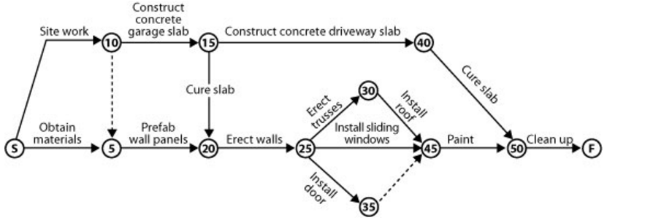
PERT CHART
Notes:
● All of the individual tasks to complete a program must be clear enough to be put down in a network, which comprises events and activities; i.e., follow the work breakdown structure.
In this diagram the actual activities to be carried out are written on the arrows. The activities are set out numerically which allows for sub-events to happen in between. Gaps are left between the numbers in the nodes (circles) to allow the sub-events to fit in. On large building sites these numbers may count in 20s or 50s or even 100s, whilst on smaller jobs these could be actual days within the construction program.

Slide 27
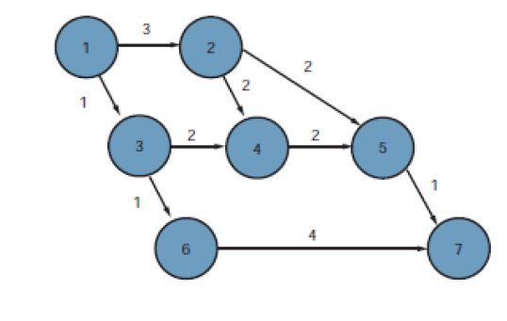
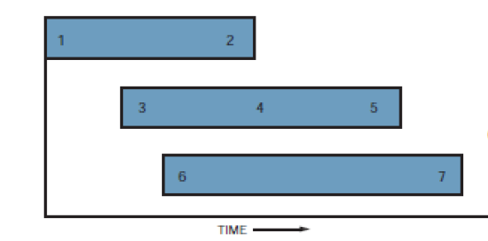
Conversion from GANTT to PERT
GANTT
PERT
Notes:
● All of the individual tasks to complete a program must be clear enough to be put down in a network, which comprises events and activities; i.e., follow the work breakdown structure.
In this diagram the actual activities to be carried out are written on the arrows. The activities are set out numerically which allows for sub-events to happen in between. Gaps are left between the numbers in the nodes (circles) to allow the sub-events to fit in. On large building sites these numbers may count in 20s or 50s or even 100s, whilst on smaller jobs these could be actual days within the construction program.

Slide 28
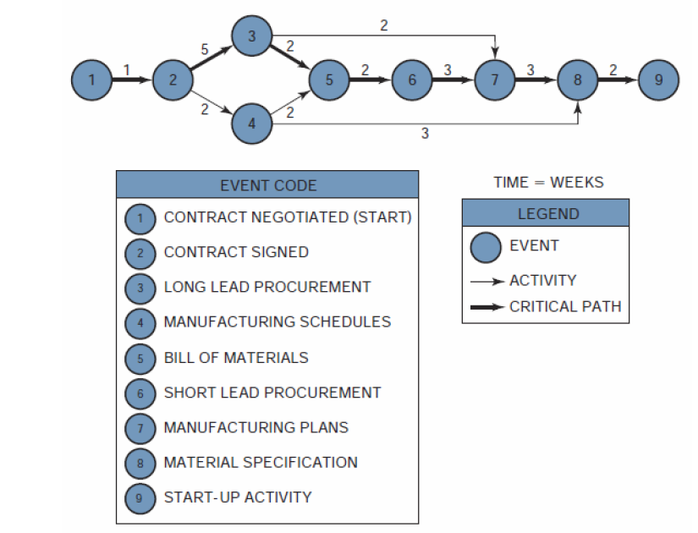
PERT Diagram
TE = 3
TL = 6
Slack = 6 -3 = 3
TE = the earliest time (date) on which an event can be expected to take place
TL= the latest date on which an event can take place without extending the completion date of the project
Slack time = TL -TE
Notes:
Since there exists only one path through the network that is the longest, the
other paths must be either equal in length to or shorter than that path. Therefore, there must exist events and activities that can be completed before the time when they are actually needed. The time differential between the scheduled completion date and the required date to meet critical path is referred to as the slack time. In Figure 3.4, event 4 is not on the crucial path. To go from event 2 to event 5 on the critical path requires seven weeks taking the route 2–3–5. If route 2–4–5 is taken, only four weeks are required. Therefore, event 4, which requires two weeks for completion, should begin anywhere from zero to three weeks after event 2 is complete.
Event 1 serves as the reference point for the network and could just as easily have been defined as a calendar date. As before, the critical path is represented as a bold line. The events on the critical path have no slack (i.e., TL =TE) and provide the boundaries for the noncritical path events.5 Since event 2 is critical, TL = TE 3 + 7= 10 for event 5. Event 6 terminates the critical path with a completion time of fifteen weeks.
The earliest time for event 3, which is not on the critical path, would be two weeks (TE 0 + 2= 2), assuming that it started as early as possible. The latest allowable date is obtained by subtracting the time required to complete the activity from events 3 to 5 from the latest starting date of event 5. Therefore, TL (for event 3) =10 - 5 = 5 weeks. Event 3 can now occur anywhere between weeks 2 and 5 without interfering with the scheduled completion date of the project. This same procedure can be applied to event 4, in which case TE 6 and TL 9.

Slide 29
Activity 2
What is the earliest completion time for the project?
What is earliest start time for activity 4?
What is the late start time for activity 4?
What is the early finish time for acivity 4?
What is the late finish time for activity 4?
Notes:
To make full use of the capabilities of PERT/CPM, we could identify four values:
● The earliest time when an activity can start (ES)
● The earliest time when an activity can finish (EF)
● The latest time when an activity can start (LS)
● The latest time when an activity can finish (LF).
To calculate the earliest starting times, we must make a forward pass through the network (i.e., left to right). The earliest starting time of a successor activity is the latest of the earliest finish dates of the predecessors. The earliest finishing time is the total of the earliest starting time and the activity duration.

Slide 30
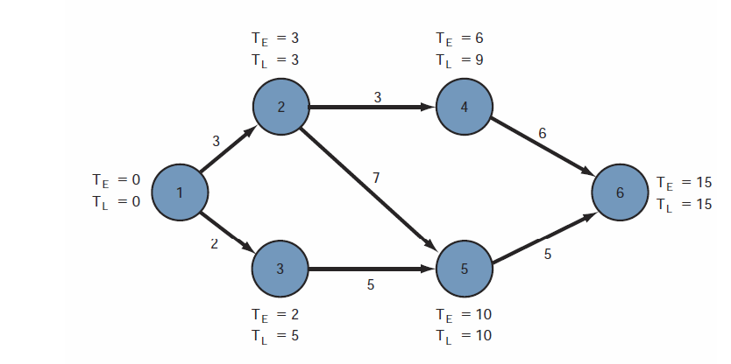
Example 2

Slide 31
ASSIGNMENT

Slide 32
Project – Ticketing software replacement
Phases – Design, Test, Build, Deploy, Support
Departments = Computing and Network; Information Services; Instruction and Research; User Support Services
Timeline = 6 months
Phase 1 = Team collected requirments (Prefeasibility or Conceptualisation – options were explored and discussed at meetings. Information gathering took 3 months. Decision – replace remedy with Request Tracker.
Phase 2 Migration – Moving only some departments from Remedy to RT. (Resources – Ron Himself –team lead plus Harry plus one programmer from Harrys group.
Ron – team lead plus create user interface
Harry and team – replace remedy, patch, update etc.
The transition was done by November of that year, one month sooner than the expected schedule of six months.
We need to fix the ticketing system

Slide 33
1.1
Replace ticket system
Conceptualise
Feasibility
Migration
Training
Gather requirements
Design
Investigate Solutions
Per departmetns
Build
Brainstorming
Meetings
Conduct weekly meeting
Test
Research
Articles
White papers

Slide 34
1.2
Categorise the risks; identify the risks,
• Technical
• Schedule
• Cost
• Human resources
• External
• Sponsor/customer
Analyse and quantify the risk
Market or price risk
Interest rates risk
Liquidity
Legal risk
Operational risk
Rate the risk in terms of
Frequency
Severity
Multiply the frequency by the severity
Prioritise the ratings
• Eliminate risk.
• Mitigate risk.
• Deflect risk.
• Accept risk (contingency).
• Turn risk into an opportunity.

Slide 35
MONITORING AND EVALUATION

Slide 36
Reasons for project planning
Graphs and charts are intended to communicate project progress to an intended audience. The final form of the schedule may be:
Bar chart
Graphs
Tables
Bubble Charts
Logic Diagrams

Slide 37
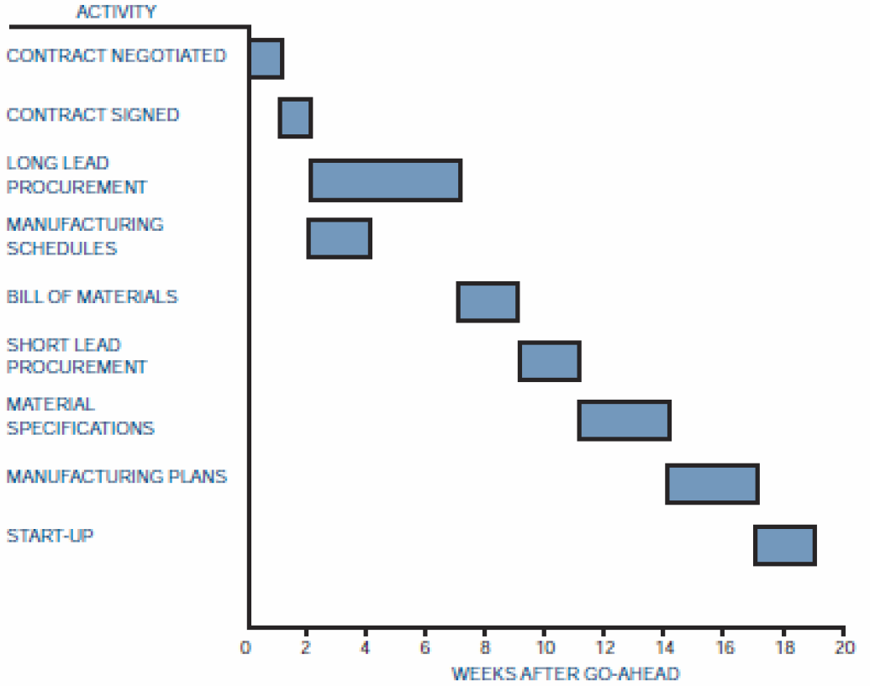
Bar Chart
Notes:
Bar charts provide only a vague description of how the entire program or project
reacts as a system, and have three major limitations. First, bar charts do not show the interdependencies of the activities, and therefore do not represent a “network” of activities.
The second major discrepancy is that the bar chart cannot show the results of either an early or a late start in activities.
The third limitation is that the bar chart does not show the uncertainty involved in performing the activity and, therefore, does not readily admit itself to sensitivity analysis.

Slide 38
PROJECT COST MANAGEMENT

Slide 39
Pricing Strategies
Type 1 Acquisition
Type 2 Acquisition
Develop cost model and estimating guidelines; design proposed project baseline for minimum cost to minimum customer requirements
Estimate cost realistically for minimum requirements.
Scrub the baseline. Squeeze out unnecessary costs.
Determine realistic minimum costs.
Adjust cost estimate for risks.
Add margin and determine price.
Compare price to customer budget.
Bid only if price within competitive range
Design project baseline compliant with customer requirements with innovative features but minimum risk
Estimate costs realistically.
Scrub baseline. Squeeze out unnecessary costs.
Determine “should cost” including risk adjustment.
Compare final cost estimate to customer budget and the most likely winning price.
Determine gross margin. This could be negative.
Decide whether gross margin is acceptable.
Determine the most likely bid price
If the bid price is below cost – provide explanation of source of additional funds.
Notes:
Frequently, however, one of two situations prevail when one is pursuing project acquisitions competitively.

Slide 40
Estimates
Order of magnitude
Approximate
Definitive
No detailed data
Accuracy of 35%
Top down approach
Based on statistical
May use historical data
Top-down
No detailed data
Based on similar projects
Adjust for capacity
Adjust for technology
Well defined data
Includes vendor quotes
Complete plans
Detailed specifications
Accuracy of 5%
Notes:
You contact a construction contractor who informs you that the parametric or statistical cost for a home in this suburb is $120 per square foot. In Los Angeles, the cost may be $4150 per square foot.
This type of estimate is prorated from previous projects that are similar in scope and capacity, and may be titled as estimating by analogy, parametric curves, rule of thumb, and indexed cost of similar activities adjusted for capacity and technology.

Slide 41
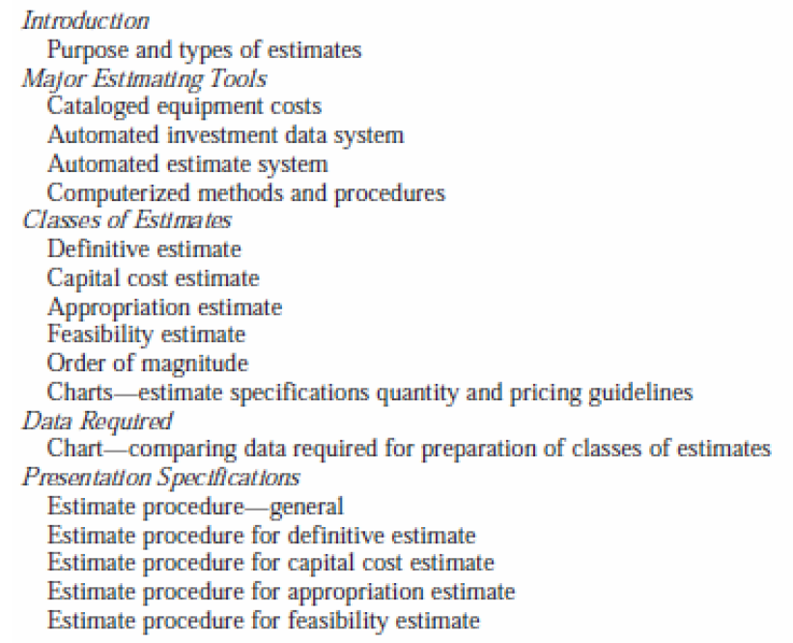
Estimating Manual Table of Contents
Notes:
Not all companies can use estimating manuals. Estimating manuals work best for repetitive tasks or similar tasks that can use a previous estimate adjusted by a degree-of difficulty factor. Activities such as R&D do not lend themselves to the use of estimating manuals other than for benchmark, repetitive laboratory tests.

Slide 42
Pricing Process
Activity Schedule
Work Breakdown Structure
Cost data
Price
Notes:
. The work breakdown structure and activity schedules are priced out through the lowest pricing units of the company. It is the responsibility of these pricing units, whether they be sections, departments, or divisions, to provide accurate and meaningful cost data (based on historical standards, if possible). All information is priced out at the lowest level of performance required, which, from the assumption of Chapter 3, will be the task level.

Slide 43
Work Breakdown Structure – Apex Manufacturing
PROGRAM
(01-00-00): Assembly Line Modification
PROJECT 2
(01-02-00): Assembly
PROJECT 1
(01-01-00): Initial Planning
Task 1
(01-01-01): Engineering Control
Task 2
(01-01-02): Engineering Development
Task 1
(01-02-01): Modification
Task 2
(01-02-02): Testing
Notes:
. The work breakdown structure and activity schedules are priced out through the lowest pricing units of the company. It is the responsibility of these pricing units, whether they be sections, departments, or divisions, to provide accurate and meaningful cost data (based on historical standards, if possible). All information is priced out at the lowest level of performance required, which, from the assumption of Chapter 3, will be the task level.

Slide 44
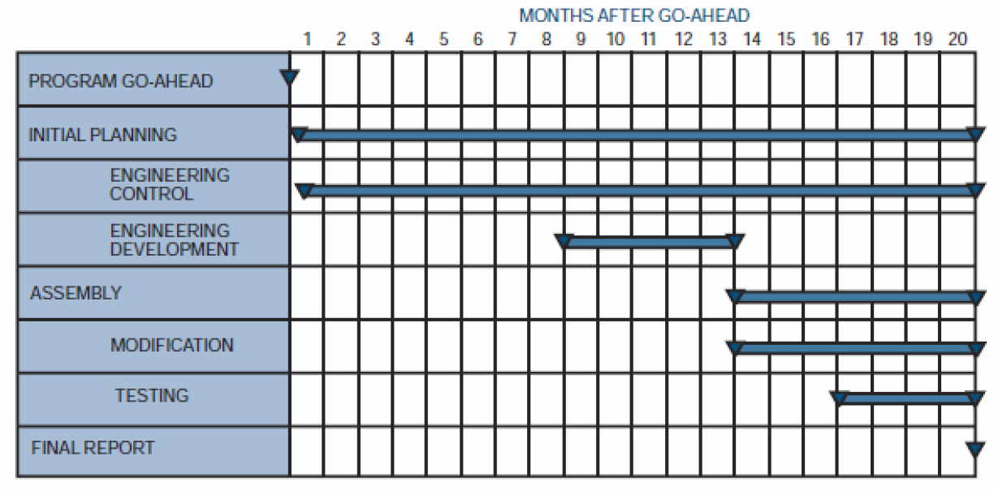
Work Breakdown Structure – Apex Manufacturing
Notes:
After the planning and pricing charts are approved by program team members and program managers, they are entered into an electronic data processing (EDP) system as shown in Figure 5.4. The computer then prices the hours on the planning charts using the applicable department rates for preparation of the direct budget time plan and estimate- at-completion reports. The direct budget time plan reports, once established, remain the same for the life of the contract except for customer-directed or approved changes or when contractor management determines that a reduction in budget is advisable

Slide 45
Types of costs
Fixed Costs: These costs stay the same and do not change throughout the project life cycle. Examples of fixed costs include setup costs, rental costs etc.
Variable Costs: Variable costs are costs that change with the amount of work. Examples of variable costs are hourly labor, the cost of material, the cost of supply, fuel for bulldozer etc.
Direct Costs: Direct costs are expenses that are billed directly to the project. Examples of direct costs are team travel expenses, team wages, the cost of material used in a project, costs incurred for materials used to construct a building.
Indirect Costs: Indirect costs are costs that are shared and allocated among several or all projects. Examples include fringe benefits and taxes. Another example of indirect costs could be the salary of an architect or a project manager who is partially allocated across many projects.
Sunk Costs: Sunk costs are costs that have been incurred on a project but have not produced value towards the project objectives. Sunk costs are like spilled milk.If they are unrecoverable, they are to be treated as if they are irrelevant.
Overhead Costs: Overhead costs are those general costs that are the costs of doing business not directly attributed to any one individual. They are shared proportionally across the project as a percentage. Eg. Telephone, office expenses.
Notes:
As an example lets say a contractor does R1m business for the year. He calculates that his running expenses is 100000 then his overhead cost is 10%

Slide 46
Project Financing Methods
Payback Period
Discounted Cash Flow (DCF)
Net Present Value (NPV)
Internal Rate of Return (IRR)
Notes:
As an example lets say a contractor does R1m business for the year. He calculates that his running expenses is 100000 then his overhead cost is 10%

Slide 47
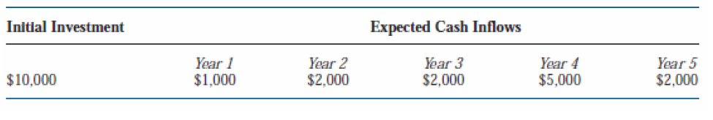
Payback period
The payback period is the exact length of time needed for a firm to recover its initial investment as calculated from cash inflows. Payback period is the least precise of all capital budgeting methods because the calculations are in rands and not adjusted for the time value of money.
Notes:
Project A will last for exactly five years with the cash inflows
shown. The payback period will be exactly four years. If the cash inflow in Year 4 were $6,000 instead of $5,000, then the payback period would be three years and 10 months.

Slide 48
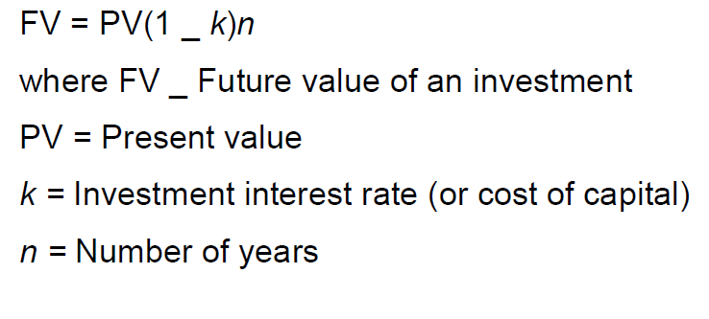
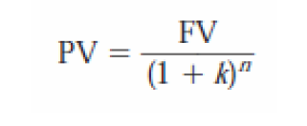
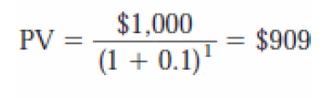
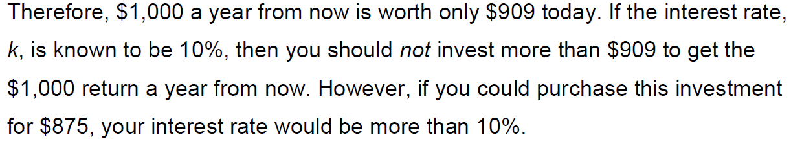
Discounted Cash Flows
Notes:
The problem with the payback method is that $5,000 received in Year 4 is not worth $5,000 today. This unsophisticated approach mandates that the payback method be used as a supplemental tool to accompany other methods.
5.11.2

Slide 49
Exercise
Investment A will generate $100,000 two years from now and investment B will generate $110,000 three years from now. If the cost of capital is 15%, which investment is better?
Notes:
PVA = $75,614
PVB = $72,327
This implies that a return of $100,000 in two years is worth more to the firm than a $110,000 return three years from now.

Slide 50
Exercise
Investment A will generate $100,000 two years from now and investment B will generate $110,000 three years from now. If the cost of capital is 15%, which investment is better?
Notes:
PVA = $75,614
PVB = $72,327
This implies that a return of $100,000 in two years is worth more to the firm than a $110,000 return three years from now.

Slide 51
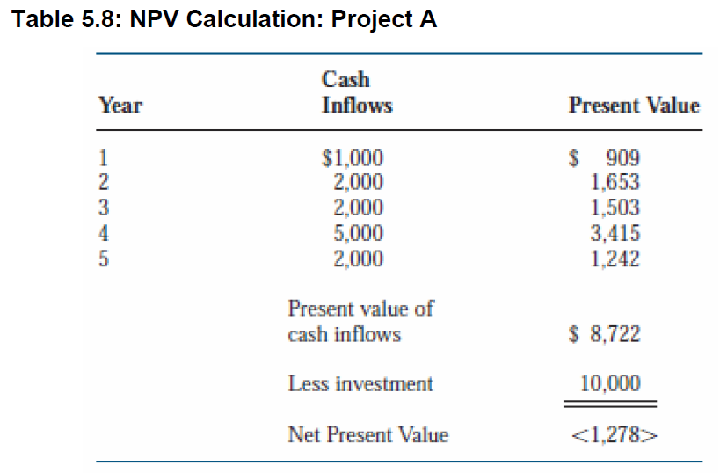
Net Present Value
the present value of future cash minus the present value of the cost of the investment. The formula is NPV = PV - cost
Notes:
This indicates that the cash inflows discounted to the present will not recover the initial investment. This, in fact, is a bad investment to consider. Previously, we stated that the cash flow stream yielded a payback period of four years.
● If the NPV is greater than or equal to zero dollars, accept the project.
● If the NPV is less than zero dollars, reject the project.
A positive value of NPV indicates that the firm will earn a return equal to or greater than its cost of capital.
PVA = $75,614
PVB = $72,327
This implies that a return of $100,000 in two years is worth more to the firm than a $110,000 return three years from now.

Slide 52
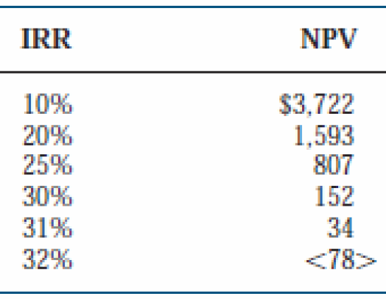
Internal Rate of Return
Is the discount rate where the present value of the cash inflows exactly equals the initial investment. The solution to problems involving IRR is basically a trial-and-error solution. The example below shows that with the cash inflows provided, and with a $5,000 initial investment, an IRR of 10% yielded a value of $3,722 for NPV. Therefore, as a second guess, we should try a value greater than 10% for IRR to generate a zero value for NPV.
Notes:
The table implies that the cash inflows are equivalent to a 31% return on investment. Therefore, if the cost of capital were 10%, this would be an excellent investment. Also, this project is “probably” superior to other projects with a lower value for IRR.

Slide 53
Comparing IRR, NPV and Payback
For most projects, both IRR and NPV will generate the same accept /reject decision. The major problem is the differences in the magnitude and timing of the cash inflows.
NPV assumes that the cash inflows are reinvested at the cost of capital
IRR assumes reinvestment at the project’s IRR. NPV tends to be a more conservative approach.
Notes:
The table implies that the cash inflows are equivalent to a 31% return on investment. Therefore, if the cost of capital were 10%, this would be an excellent investment. Also, this project is “probably” superior to other projects with a lower value for IRR.

Slide 54
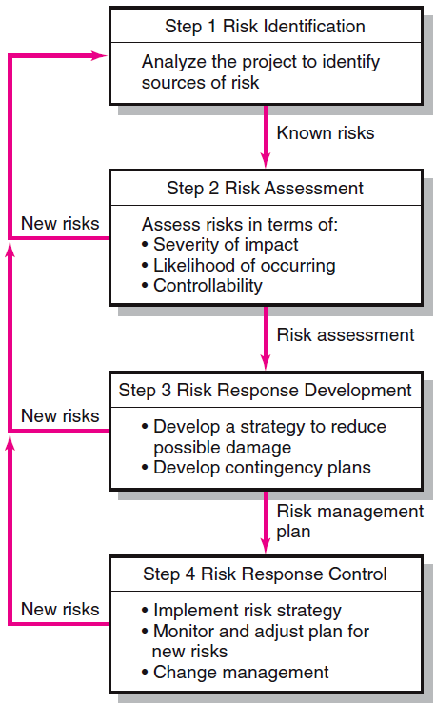
Risk Management Process
Generate a list of possible risks through
brainstorming,
historical data,
risk profiling.
Conduct scenario analysis for event probability and impact.
Compile risk assessment matrix
Conduct Failure Mode and Effects Analysis (FMEA)
Mitigate the risk
Avoid the risk
Transfer the risk
Retain the risk
Execute risk response strategy
Initiate contingency plans
Watch for new risks
Repeat risk identification exercise
Document risk resolution
Notes:
As an example lets say a contractor does R1m business for the year. He calculates that his running expenses is 100000 then his overhead cost is 10%

Slide 55
Quantifying risk
Assign a category for the frequency
Assign a category for the severity
Multiply the frequency value by the severity value.
Prioritise the ratings
Notes:
As an example lets say a contractor does R1m business for the year. He calculates that his running expenses is 100000 then his overhead cost is 10%

Slide 56
Responding to the risk
Eliminate risk.
Mitigate risk.
Deflect risk.
Accept risk (contingency).
Turn risk into an opportunity.
Notes:
As an example lets say a contractor does R1m business for the year. He calculates that his running expenses is 100000 then his overhead cost is 10%

Slide 57
Risk Prioritisation Analysis
Example: Severity Impact Assessment
 |  | Technical Performance | Cost | Schedule
5 Severe | Severe impact on achieving desired results. One or more critical objectives will not be achieved. | Performance unacceptable. Does not meet requirements. | Program budget impacted by greater than 50% | Increase critical path schedule by more than 3 months.
4 Significant | Significant impact on achieving desired results. One or more objectives will fall below acceptable levels. | Performance unacceptable . Significant changes required. | Program budget impacted between 30 and 49% | Increase critical path schedule by 2-3 months.
3 Moderate | Moderate impact on achieving desired results. | Performance below goals. Moderate changes required. | Program budget impacted between 10 and 29% | Increase critical path schedule by 1- 2 months.
2 Minor | Minor impact on achieving desired results. | Performance below goals but within acceptable limits. No changes required. | Program budget impacted between 0 and 9% | Increase critical path schedule by 0- 1 month.
1 Minimal | Little or no impact on achieving desired results. | Minor performance trade-offs. | Program budget not impacted. | Schedule not affected

Slide 58
Risk Matrix
A Risk matrix is a matrix that is used during risk assessment to define the various levels of risk as the product of the probability and severity categories. This is a simple mechanism to increase visibility of risks and assist management decision making.
Risk (R) = Severity x Probability x Frequency or R = S x P x F
Severity: Describes the potential loss or consequence or a mishap.
1=none or slight 2=Minimal 3=Significant 4=Major 5=Catastrophic Probability:
Probability: Describes the likelihood that the risk event will occur.
1=Impossible or remote under normal conditions 2=Unlikely under normal conditions 3=50/50 chance 4=Greater than 50% chance 5=Very likely Exposure:
Frequency: Describes the amount of time, number of cycles involved.
1=None or below average 2=Average 3=Above average 4=Great

Slide 59
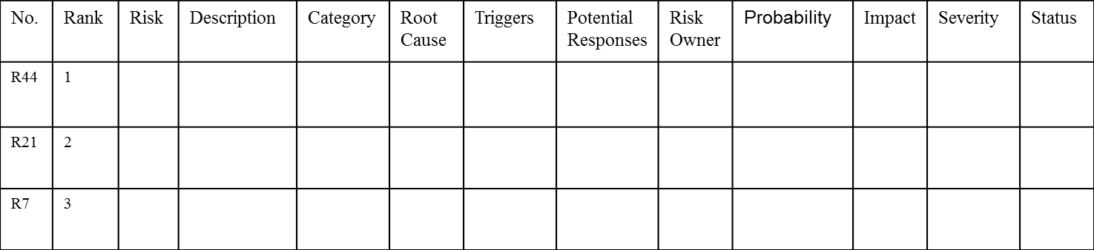
Sample Risk Register

Slide 60
Case Study
You have been appointed as the project manager for a shopping centre construction project. The area in which you are building is prone to excessive rain and occasional flooding. You are working with unfamiliar construction teams. After initial consultation with the local traffic department, it has become clear that they are not satisfied with the road layout as per your building plans. However, they did give the preliminary go-ahead for the project, with the proviso that the town engineer and town planner reconsider the plans. To date, all the suppliers you have contacted can supply all the relevant material but cannot guarantee on-time delivery.

